Slide 1

D.C Residential Property Sales
Team 2: Muhannad Alwhebie, Brian Gulko, Mengfei Hung, Kashyap Nimmagadda
DATS-6103-11
Spring 2023
The George Washington University

Slide 2
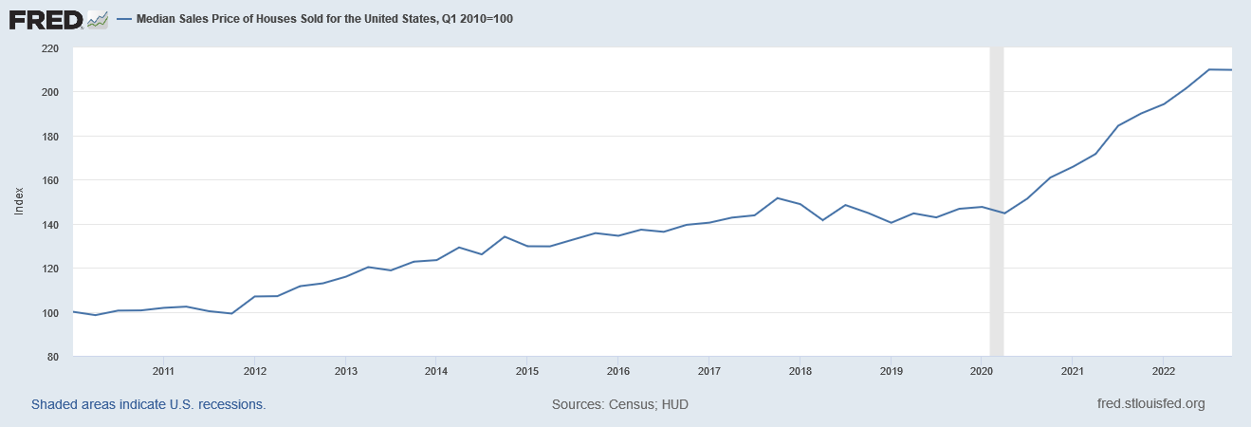
Background – U.S. Housing Prices
U.S. Census Bureau and U.S. Department of Housing and Urban Development, Median Sales Price of Houses Sold for the United States [MSPUS], retrieved from FRED, Federal Reserve Bank of St. Louis; https://fred.stlouisfed.org/series/MSPUS, April 20, 2023.

Slide 3

Background – Washington D.C. Population
2010–2020
D.C.'s population grew 15% from 2010 to 2020
2020
Nearly 690,000 residents in 2020
2021
Lost about 20,000 residents in 2021
Jan. 2023
As of January 2023, D.C currently has about 671,000 residents
Dil, C., & Hopkins, P. (2023, January 10). D.C.'s mayor has a plan to boost the city's population. Axios. Retrieved April 20, 2023, from https://www.axios.com/local/washington-dc/2023/01/10/dc-comeback-plan-pandemic-population

Slide 4
Our Data
Source: Open Data DC
Describes the sale history for active properties listed among the District of Columbia’s real property tax assessment roll
All housing types included
About 108,000 rows and 39 columns describing property attributes

Slide 5
SMART Questions
1. What are the characteristics of an average residential property?
Which heating type is the most common in residential properties in this dataset, and what is the percentage of properties with this heating type?
What is the average number of bathrooms and half-bathrooms in residential properties in this dataset?
What is the average land area of residential properties in this dataset, and how does this vary by number of bedrooms?
How has the gross building area of residential properties in this dataset changed over time?
2. Which variables have an impact on sale price, and how strong is that impact?
Is there a correlation between the number of bedrooms and the sale price of a residential property in this dataset?
Is there a correlation between the grade and the sale price of a residential property in this dataset?
Is there a correlation between gross building area and sale price?
3. Did COVID-19 have an impact on residential sale prices? If so how big was that impact?

Slide 6
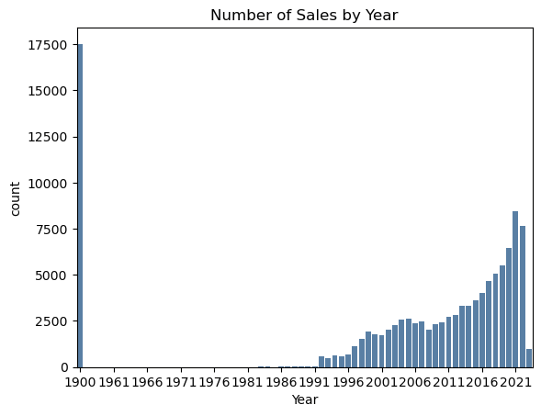
Distribution of Sales

Slide 7
Preprocessing
Selected years 2010 through 2022
Created variables:
Day, Month, and Year of Sale
Month Name
If the property sold for a price (boolean)
If the property was remodeled (boolean)
Number of days/months/years passed since January 1, 2010

Slide 8

Exploratory Data Analysis

Slide 9
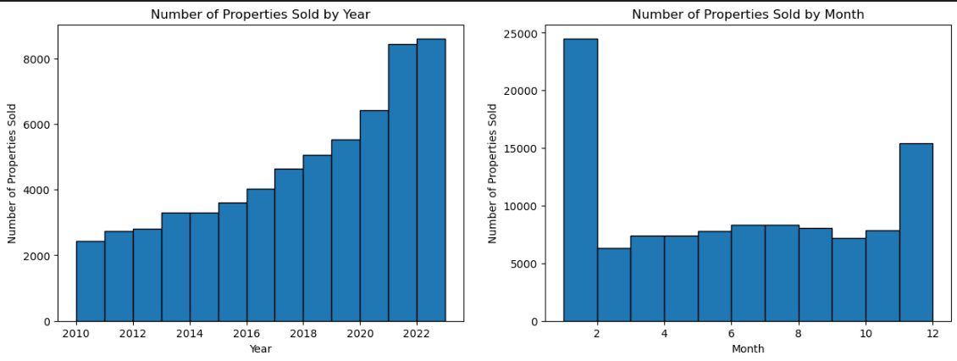
Annual and Monthly Property Sales Trends

Slide 10
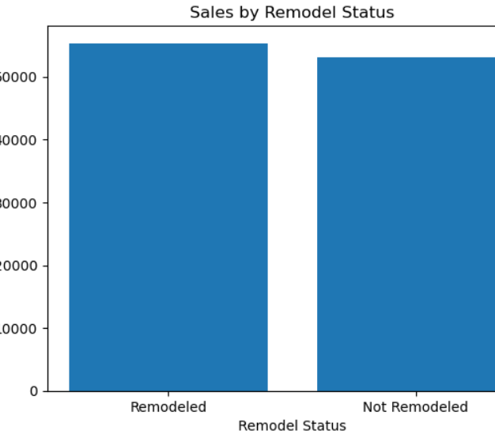
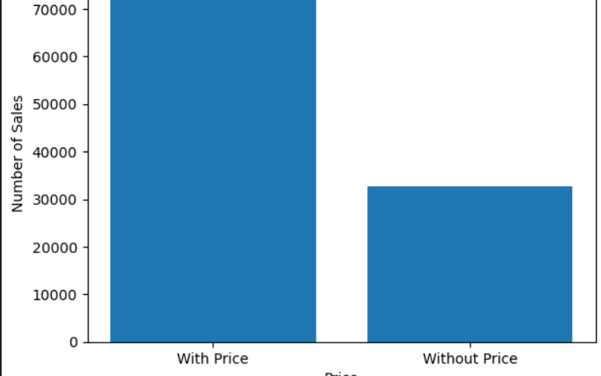
Property Sales by Price and Remodeled Status

Slide 11
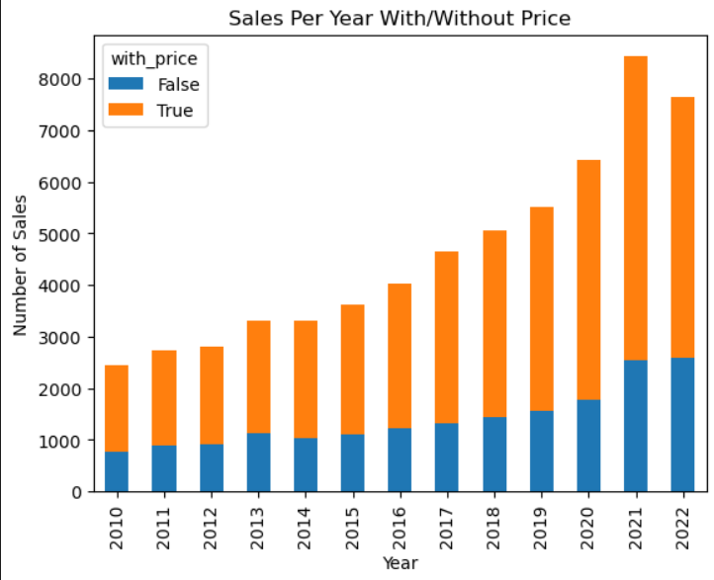
Annual Property Sales Comparison with and without Price

Slide 12
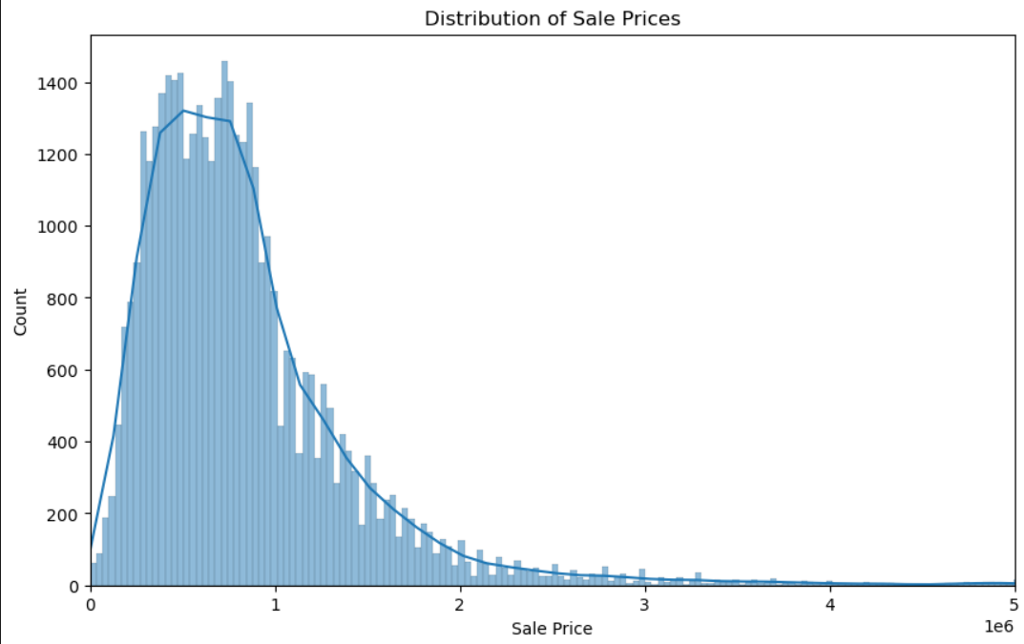
Distribution of Sale Prices for Trimmed Sales Data with KDE Plot

Slide 13
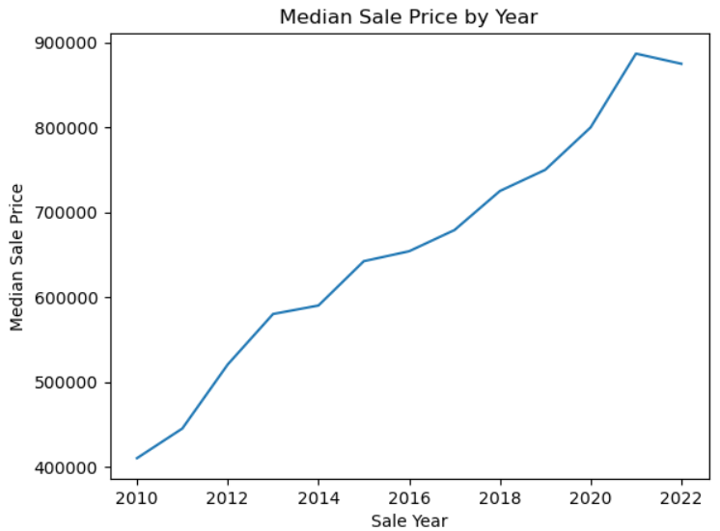
Median Sale Price by Year: Trend Analysis

Slide 14
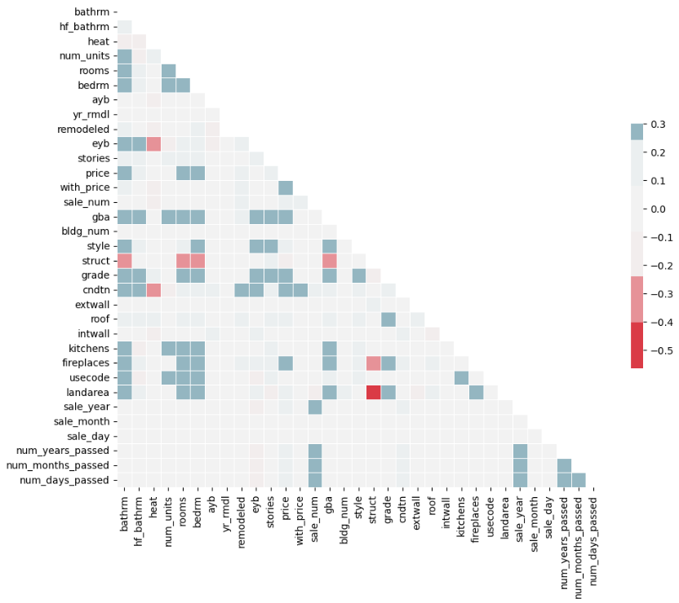
Correlation Matrix for Variables of Interest

Slide 15
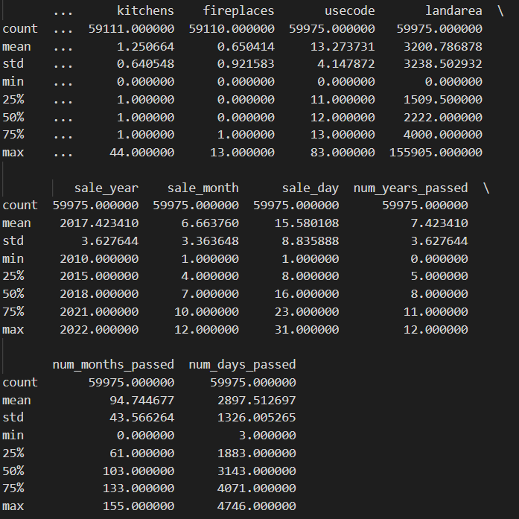
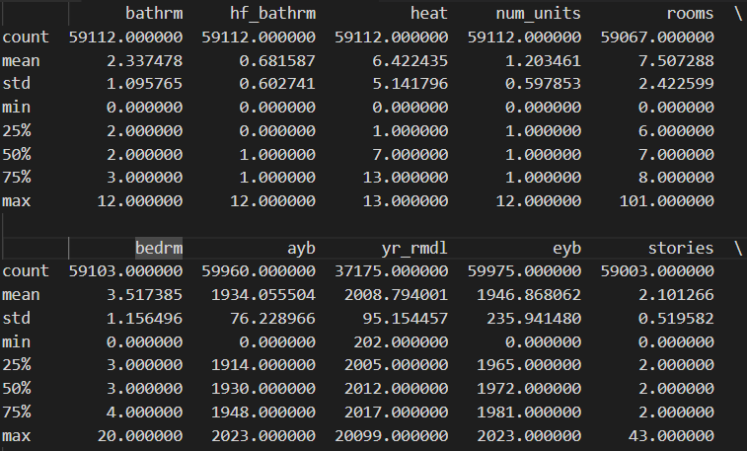
Descriptive Characteristics of Variables of Interest

Slide 16
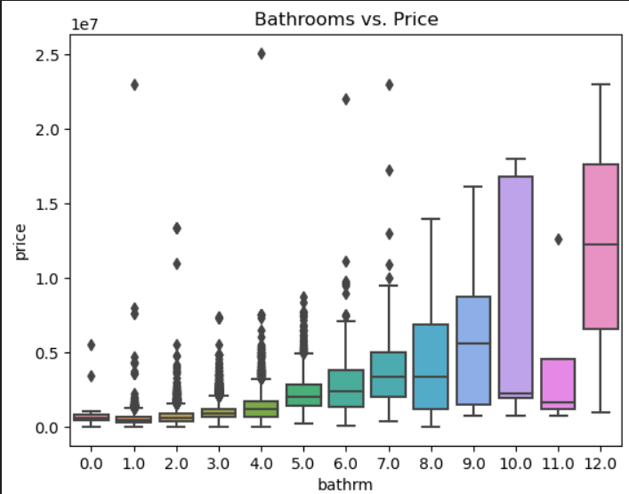
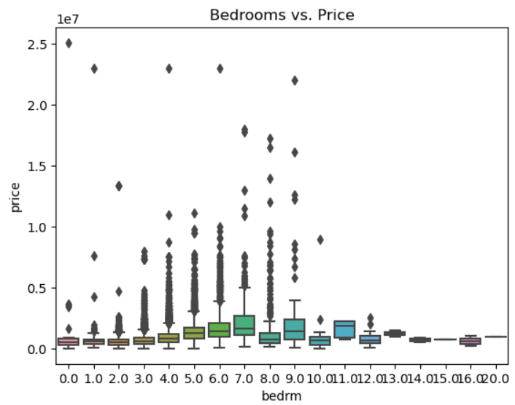
Property Sales by Price and Remodeled Status

Slide 17
Modeling

Slide 18
Model: Build LR model: Price as indep to address SMART Q
Split the data into training and test sets
X : bathrm, bedrm, grade
Y: price
Mean squared error: 222491369275.88037
R-squared: 0.5834562818092962
The mean squared error value of 222491369275.88037 suggests that the model's predictions are not very accurate.
The R-squared value of 0.5834562818092962 indicates that the model explains about 58.3% of the variance in the target variable.

Slide 19
Model: Build LR model: adding heat as predictor
X : bathrm, bedrm, grade, heat
Y: price
Mean squared error: 222194299619.75803
R-squared: 0.584012449446385
The "heat" variable was added as a predictor.
The impact of the addition of the "heat" variable on the model's performance was not significant.
The mean squared error value of the model with the "heat" variable is slightly different from the previous model.
The R-squared value of the model with the "heat" variable is also only slightly different from the previous mode

Slide 20
Model: Build LR model: adding cndtn as additional predictor variables
X : bathrm, bedrm, grade, heat, cndtn
Y: price
Mean squared error: 201704236778.56992
R-squared: 0.6223735193144329
Coefficients: [168582.12174967 13941.38958968 303630.63614983 3206.28094951
223677.38551315]
The model with additional predictor variables (heat and cndtn) has lower mean squared error and higher R-squared value, indicating an improved ability to predict sale price of residential properties.
The coefficient for bedrm is 13,941, indicating a positive correlation between the number of bedrooms and sale price.
The coefficient for grade is 303,631, indicating a strong positive correlation between the grade and sale price.

Slide 21
Model: Build LR model: adding cndtn as additional predictor variables
X : bathrm, bedrm, grade, heat, cndtn
Y: price
A one-unit increase in the number of bedrooms is associated with a $13,941 increase in sale price.
There is a positive correlation between the number of bedrooms and sale price.
A one-unit increase in grade is associated with a $303,631 increase in sale price.
There is a strong positive correlation between grade and sale price.

Slide 22
Model: Build LR model: Adding gross building area another predictor
X : bathrm, bedrm, grade, heat, cndtn, gbr
Y: price
=== Linear Regression Summary ===
Independent variables: ['bathrm', 'bedrm', 'grade', 'heat', 'cndtn', 'gba']
Dependent variable: price
Training data size: 22768
Test data size: 5692
Mean squared error: 164000452713.67236
R-squared: 0.6929617603566187
Coefficients: [ 46265.24253957 -79584.46083627 212828.91252361 476.6590613 250701.28974968 442.81817169]

Slide 23
Model: Build LR model: Adding gross building area another predictor
Which variables have an impact on sale price, and how strong is that impact? - Is there a correlation between the number of bedrooms and the sale price of a residential property in this dataset? - Is there a correlation between the grade and the sale price of a residential property in this dataset?
Yes, there is a correlation between the number of bedrooms and the sale price of a residential property in this dataset. However, the correlation is negative, meaning that as the number of bedrooms increases, the sale price tends to decrease.
Yes, there is a correlation between the grade and the sale price of a residential property in this dataset. The correlation is positive, meaning that as the grade of the property increases, the sale price tends to increase as well.

Slide 24
Model: Build LR model: Adding to moodel num_days_passed as pred
X : bathrm, bedrm, grade, heat, cndtn, gbr, num_days_passed
Y: price
Mean squared error: 144529949504.21658
R-squared: 0.7294140318685725
Coefficients: [ 4.12141957e+04 -8.32798957e+04 2.10414766e+05 2.17435103e+02
2.05181051e+05 4.60737848e+02 1.11456679e+02]
The difference in R-squared values between the two models is not extremely large.
Still bedrm has a negative effect on price

Slide 25
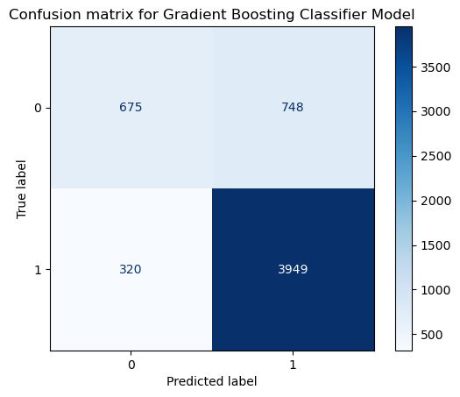
Model: Gradient Boosting Classifier model to predict property sales over $500,000
X : bathrm, bedrm, grade, heat, cndtn
Y: price
Gradient Boosting Classifier model predicts >$500,000 sale with 81% accuracy, 84% precision, and 93% recall.
Out of 5,692 properties in the test set, 4,624 were correctly classified and 1,068 were misclassified.
The model has a higher false positive rate than false negative rate as per confusion matrix

Slide 26
COVID-19 Impact

Slide 27
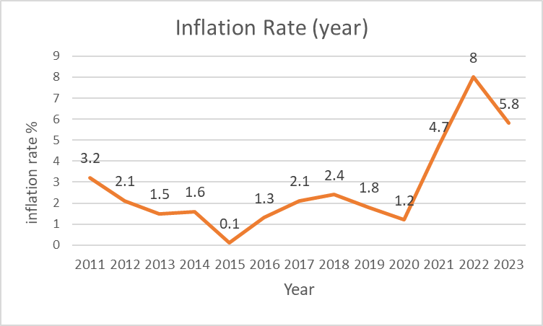
Covid impact
Selected periods:
ExAnte period: 2019-01-01~2020-02-29
During period: 2020-03-01~ 2021-07-31
ExPost period: 2021-08-01~2022-12-31
The obvious price changes before and after the COVID event.
In order to reduce the impact of price changes on house prices, the house prices are deflated by the inflation rate.

Slide 28
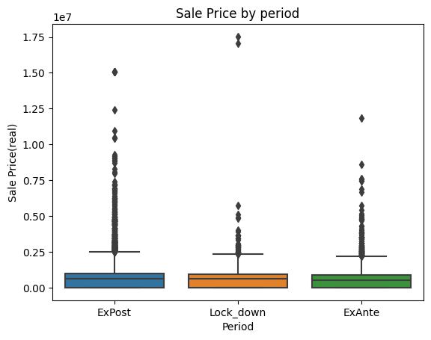
Covid impact
In comparing the house price levels with Gross building area in square feet, the number of bedrooms, and the number of bathrooms, there seem to be different price levels between the three periods.

Slide 29
Covid impact
In comparing the house price levels with Gross building area in square feet, the number of bedrooms, and the number of bathrooms, there seem to be different sailing number between the three periods.

Slide 30
Covid impact
ANOVA test
Reject Ho in housing price and house sale number test
The average housing price is different within the ex-ante, during, and expost periods of Covid.
Housing Price
 | sum_sq | df | F | PR(>F)
C(period) | 3.225411e+13 | 2.0 | 27.576308 | 1.085254e-12
Residual | 1.638829e+16 | 28023.0 | NaN | Na
Number of the House Sale |  | the number of house sale
 | sum_sq | df | F | PR(>F)
C(period) | 179.102981 | 2.0 | 37.522549 | 5.320413e-17
Residual | 66879.823444 | 28023.0 | NaN | NaN

Slide 31
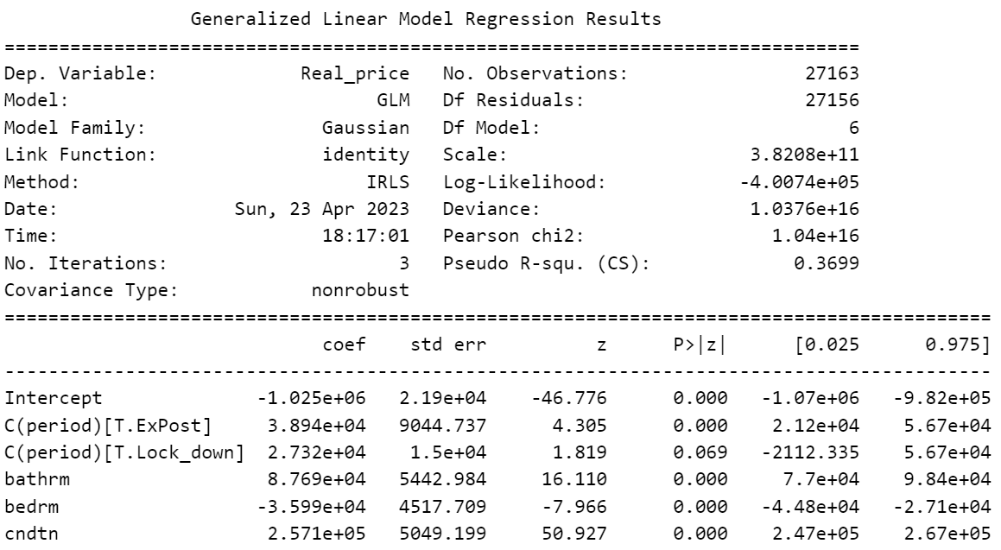
Covid impact
The period has positive impact on housing price.
Compared Ex-ante period, whether during or after Covid, housing price increased.

Slide 32
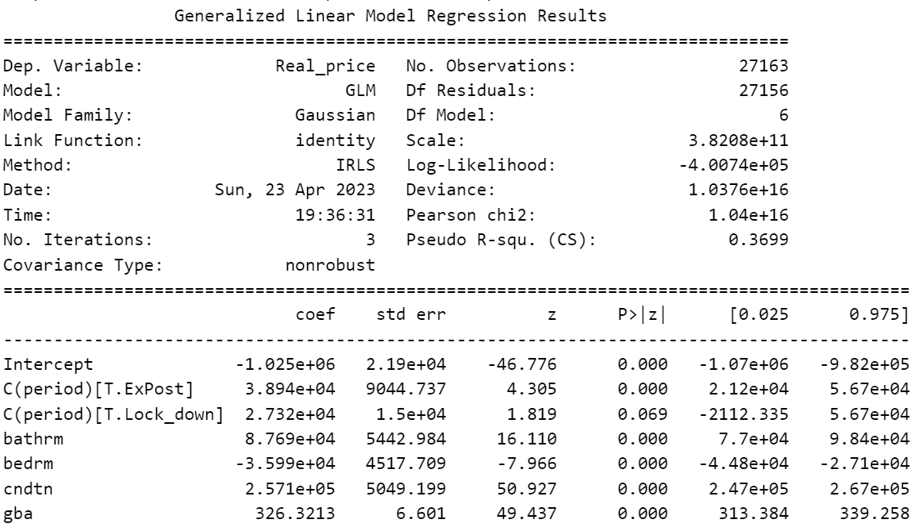
Covid impact
The period has positive impact on sailing number.
Compared Ex-ante period, whether during or after Covid, sailing number increased.

Slide 33
Covid impact
What reasons boost the housing market?
An increase in the demand for housing is associated first with social distancing and quarantining, and with the widespread adoption of work from home technology. (J Hous Econ., 2023)
During the pandemic, very low mortgage interest rates raised the demand for housing. The pandemic also boosted the demand for housing by increasing the need to work from home and for more socially distanced housing away from dense urban areas (Federal Reserve Bank of Dallas, 2021).

Slide 34
Reference
Schwartz, A. E., & Wachter, S. (2022). COVID-19’S IMPACTS ON HOUSING MARKETS: INTRODUCTION. Journal of Housing Economics.
John V. Duca, Anthony Murphy (2021). Why House Prices Surged as the COVID-19 Pandemic Took Hold. Federal Reserve Bank of Dallas. https://www.dallasfed.org/research/economics/2021/1228

